Slide 1
6 Registers and Counters
26年 11月 8日
ASIC LAB

Slide 2
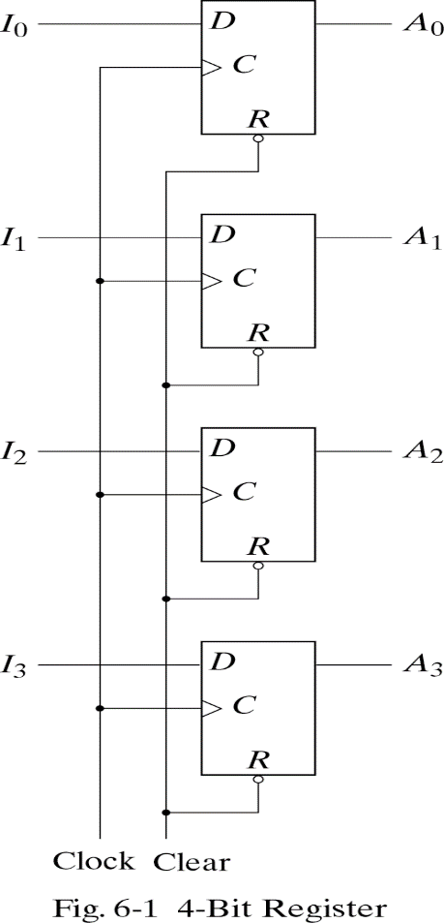
6.1 REGISTERS
Register- a group of binary cells suitable for holding binary information.
Clock=1 ;input information transferred
Clock=0 ;unchanged
Clear=0 ;clearing the register to all 0’s prior to its clocked operation.
26年 11月 8日

Slide 3
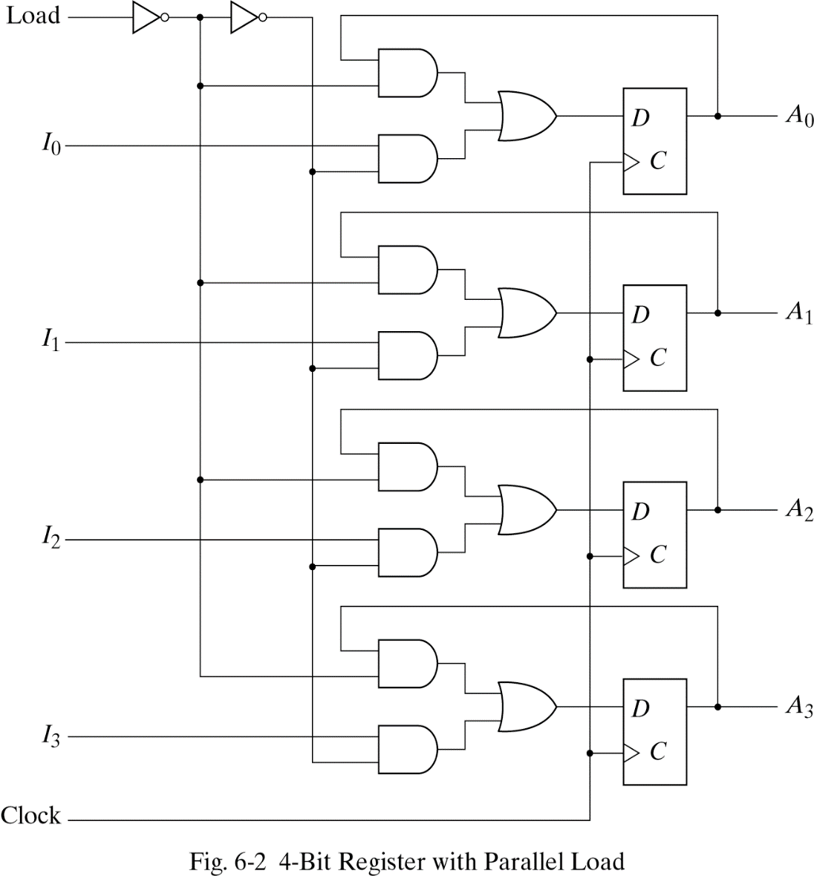
Register with Parallel Load
Clock=1 ;input information
->loading
Clock=0 ;the content of the register ->unchanged
Load input=1 ; the I inputs are transferred into the register
Load input=0 ; maintain the content of the register
26年 11月 8日

Slide 4
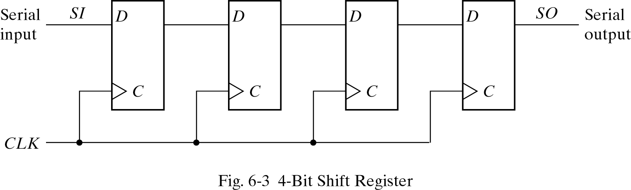
6.2 SHIFT REGISTERS
Shift register-capable of shifting its binary information in one or both directions
The simplest shift register
26年 11月 8日

Slide 5
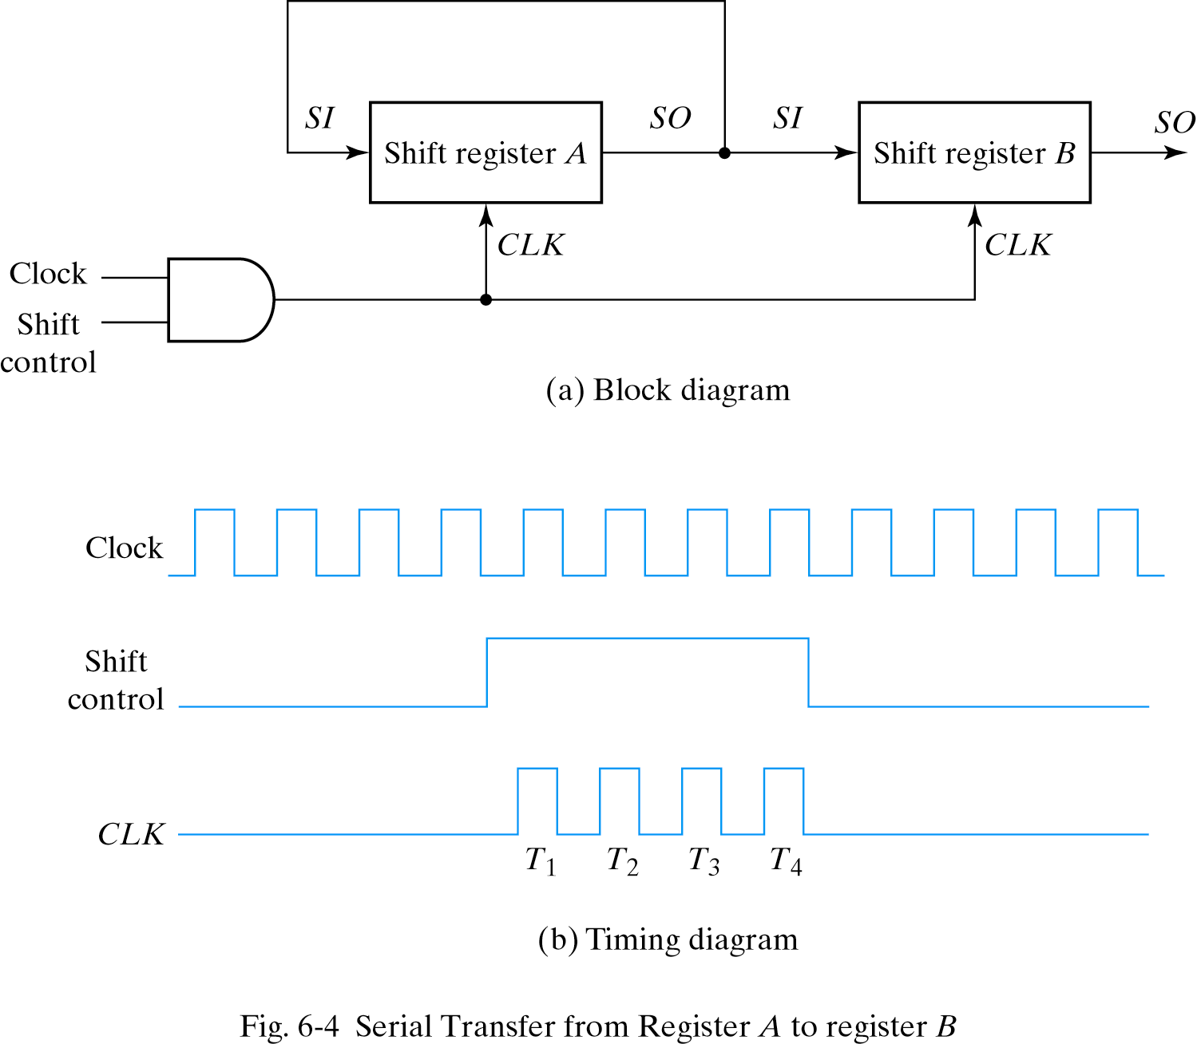
Serial Transfer
To prevent the loss of information stored in the source register
26年 11月 8日

Slide 6
Serial-Transfer Example
Timing pulse
Initial value
Shift register A
Shift register B
Serial output of B
1 0 1 1
0 0 1 0
0
After T1
After T2
1 1 0 1
1 1 1 0
1 0 0 1
1 1 0 0
1
0
0
1
After T3
After T4
0 1 1 1
1 0 1 1
0 1 1 0
1 0 1 1
26年 11月 8日

Slide 7
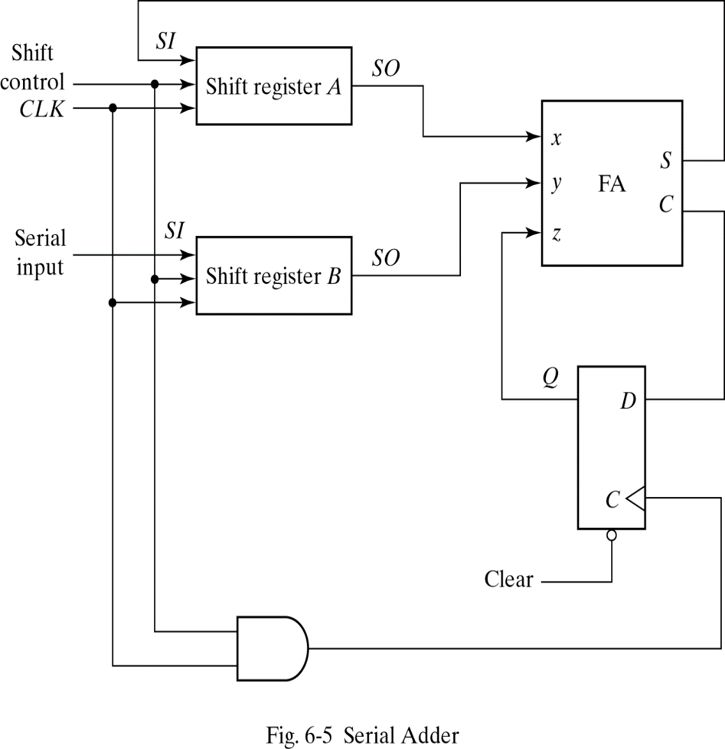
Serial Addition
For storing sum
Operation
the A register ->augend ,the B register ->addend ,carry ->0
The SO of A and B provide a pair of significant bits for the FA
Output Q gives the input carry at z
The shift-right control enables both registers and the carry flip-flop.
The sum bit from S enters the leftmost flip-flop of A
26年 11月 8日

Slide 8
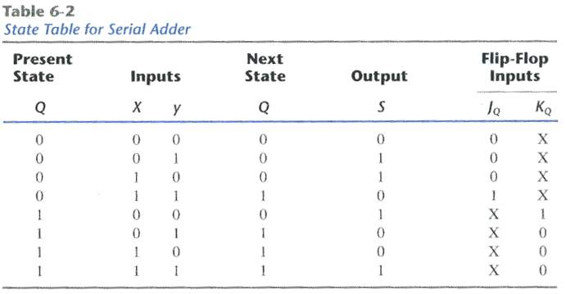
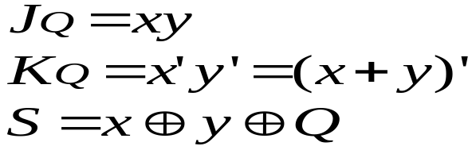
State Table for Serial Adder
Present value of carry
Output carry
By k-map
26年 11月 8日

Slide 9
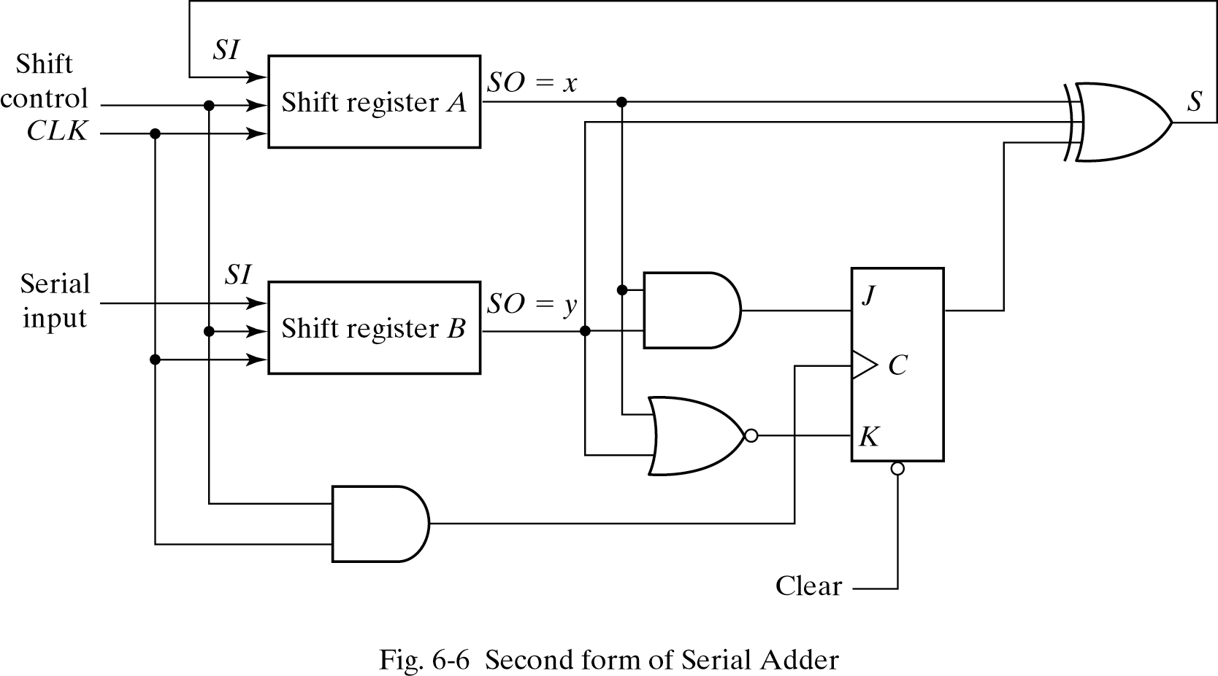
Second form of Serial Adder
26年 11月 8日

Slide 10
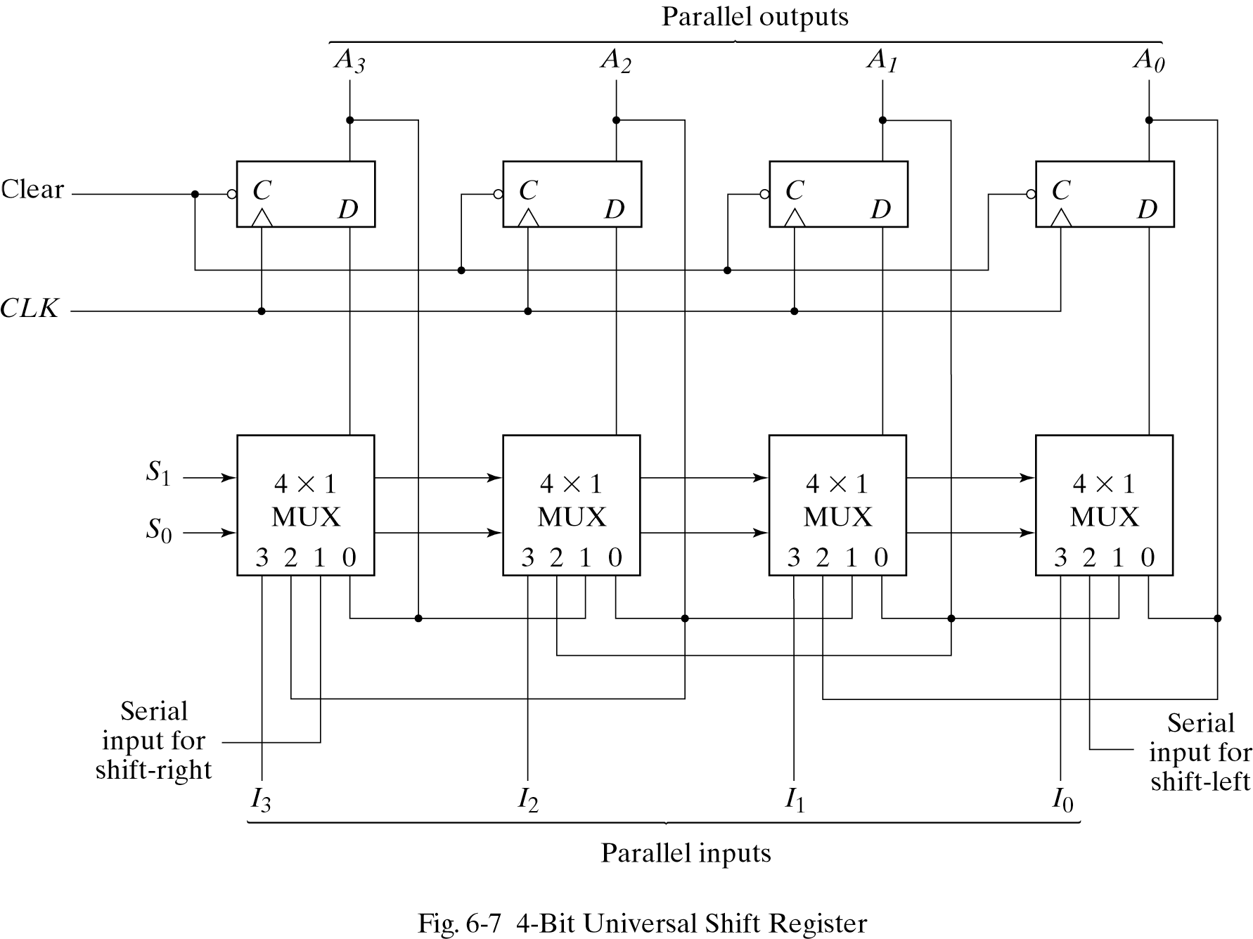
Universal Shift Register
S1, S0 -> 0, 0 ;No change
S1, S0 -> 0, 1 ;Shift right
S1, S0 -> 1, 0 ;Shift left
S1, S0 -> 1, 1 ;Parallel load
26年 11月 8日

Slide 11
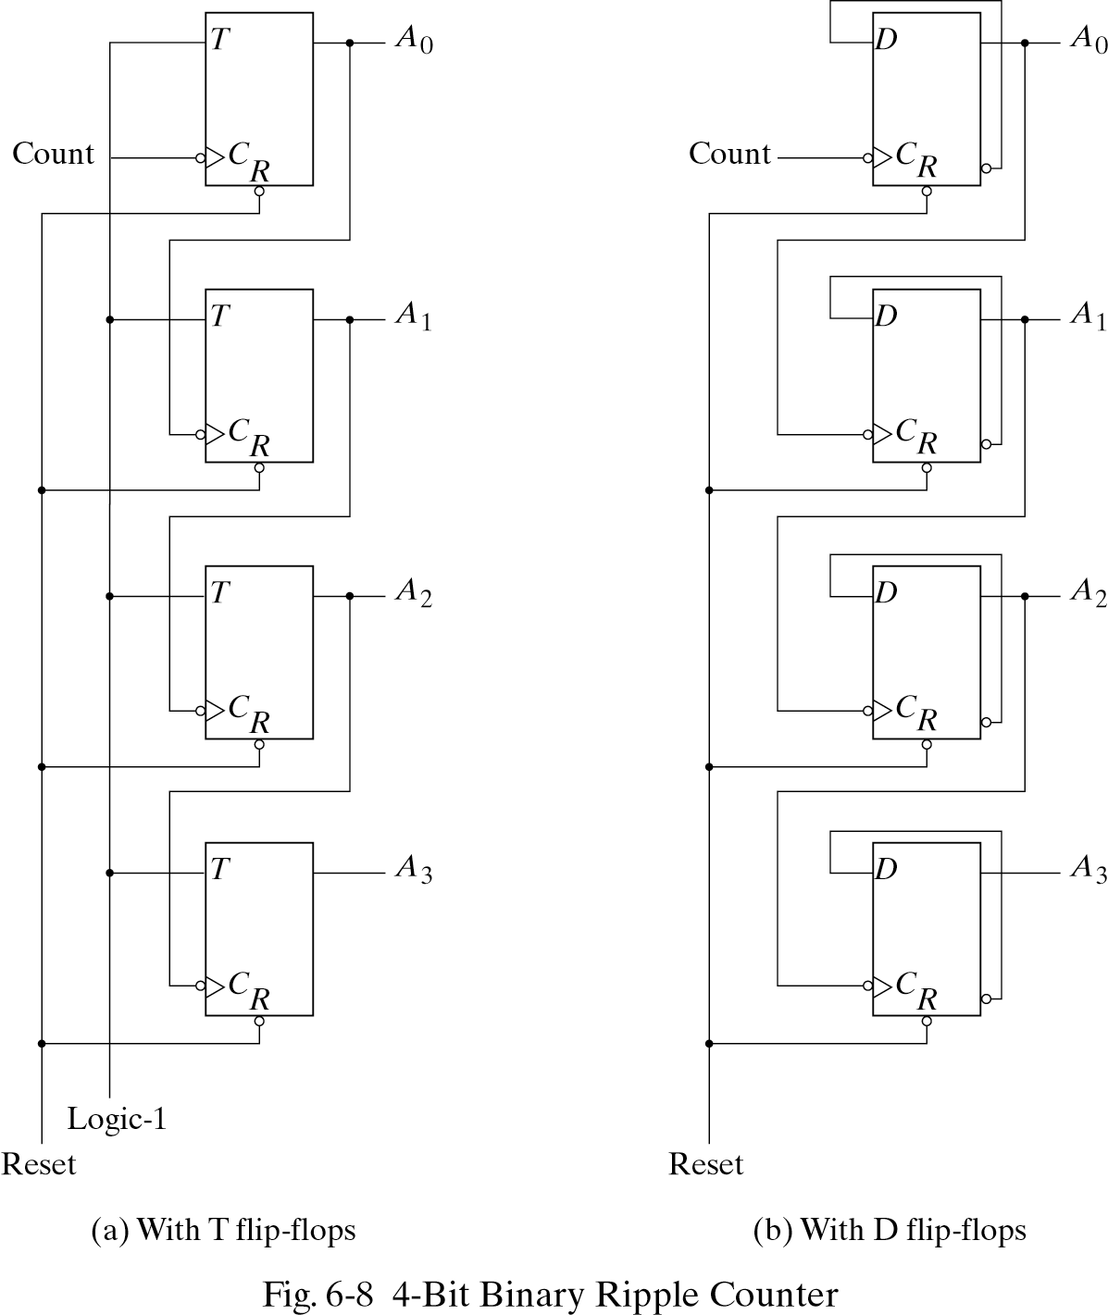
6-3 RIPPLE COUNTERS
LSB
26年 11月 8日

Slide 12
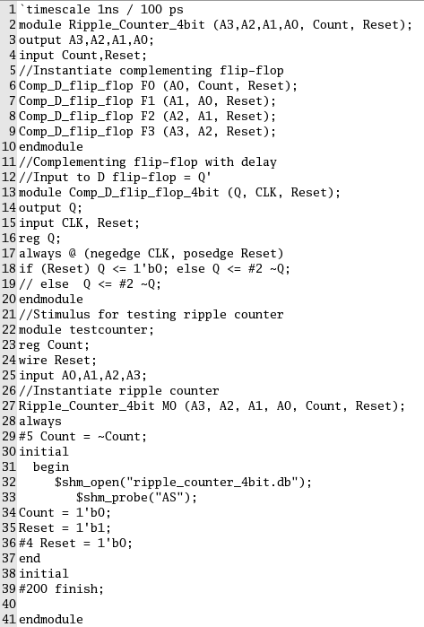
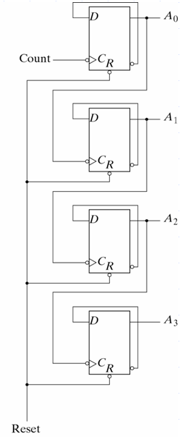
26年 11月 8日

Slide 13
Count sequence for a binary Counter
Count sequence A3 A2 A1 A0 |  | Conditions for Complementing
0 0 0 0 0 0 0 1 0 0 1 0 0 0 1 1 0 1 0 0 0 1 0 1 0 1 1 0 0 1 1 1 ……………… 1 0 0 0 | Complement A0 Complement A0 Complement A0 Complement A0 Complement A0 Complement A0 Complement A0 Complement A0 and so on… | A0 will go from 1 to 0 and complement A1 A0 will go from 1 to 0 and complement A1 ; A1will go from 1 to 0 and complement A2 A0 will go from 1 to 0 and complement A1
26年 11月 8日

Slide 14
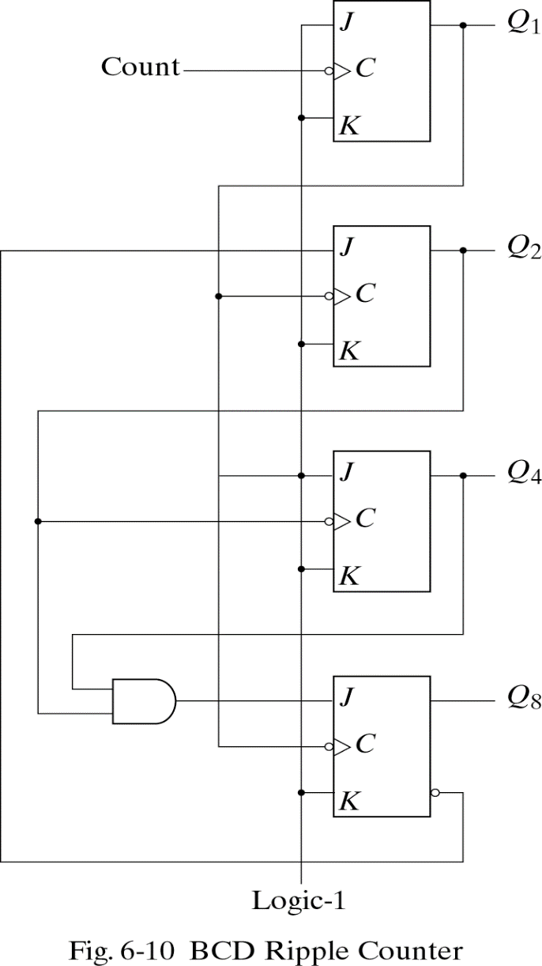
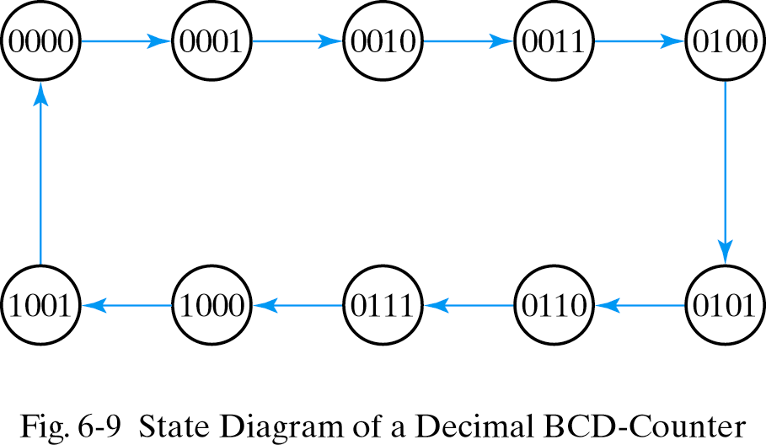
BCD Ripple Counter
26年 11月 8日

Slide 15

BCD Ripple Counter
operation
1. Q1 is complemented on the negative edge of every count pulse.
2. Q2 is complemented if Q8=0 and Q1 goes from 1 to 0. Q2 is cleared if Q8=1 and Q1 goes from 1 to 0.
3. Q4 is complemented when Q2 goes from 1 to 0.
4 . Q8 remains at 0 as long as Q4 or Q2 is 0.
Q8 is complemented when Q4Q2=11 and Q1 goes from 1 to 0.
26年 11月 8日

Slide 16
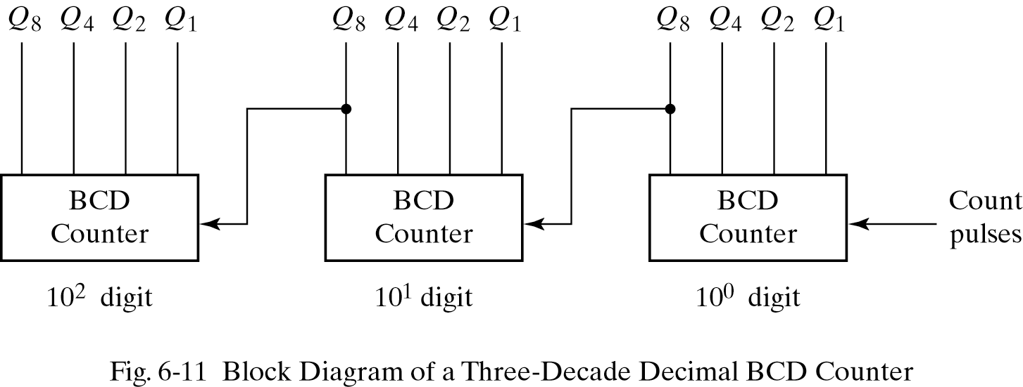
Three-Decade Decimal BCD Counter
To count from 0 to 999, We need a three-decade counter.
26年 11月 8日

Slide 17
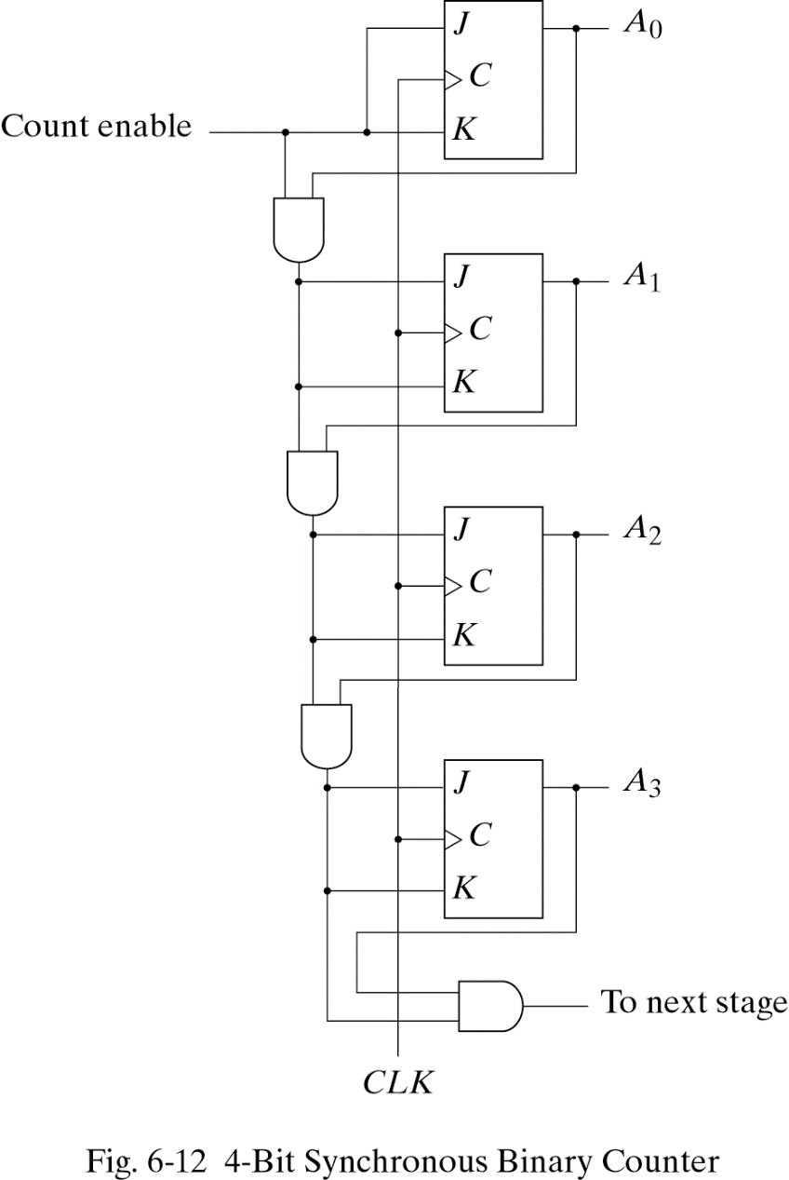
6.4 SYNCHRONOUS COUNTERS
The first stage A0 has its J and K equal to 1 if the counter is enabled .
The other J and K inputs are equal to 1 if all previous low-order bits are equal to 1 and the count is enabled.
26年 11月 8日

Slide 18
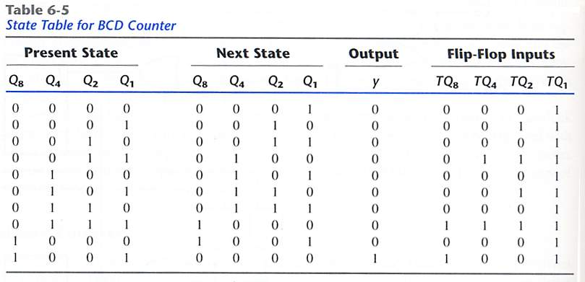
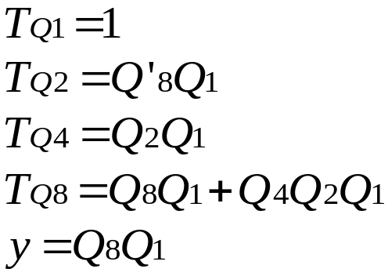
BCD Counter
26年 11月 8日

Slide 19
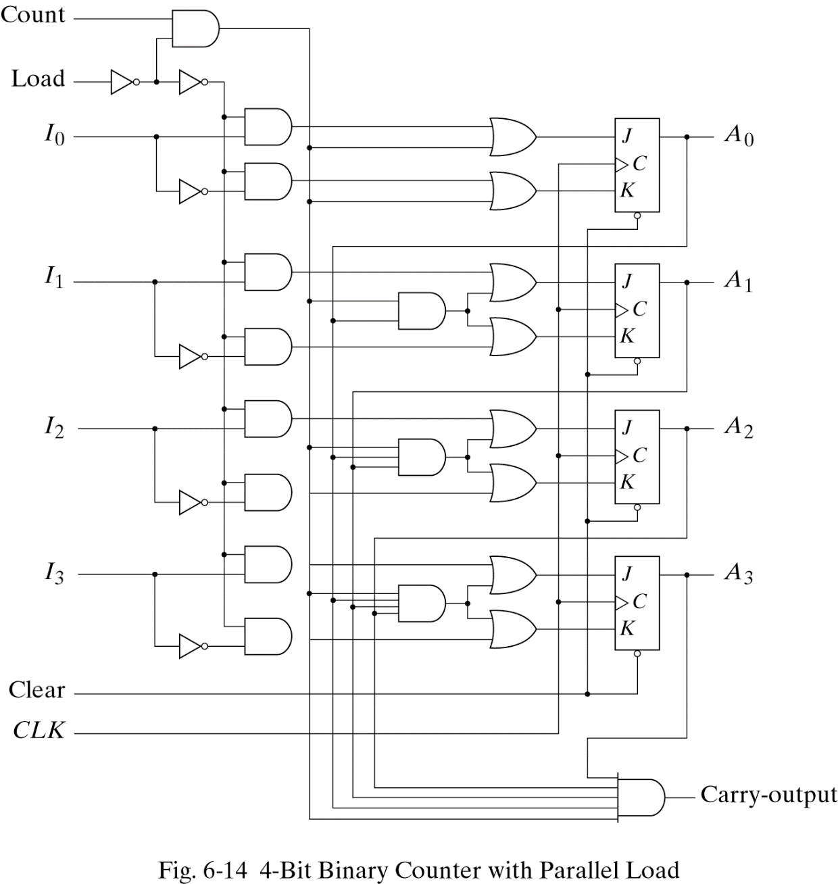
Binary Counter with Parallel Load
Input load control=1 ; disables the count sequence ,data transfer
Load =0 and count=1 ;count
Load=0 and count=0 ;unchanged
Carry out=1(all flip-flop=1)
26年 11月 8日

Slide 20
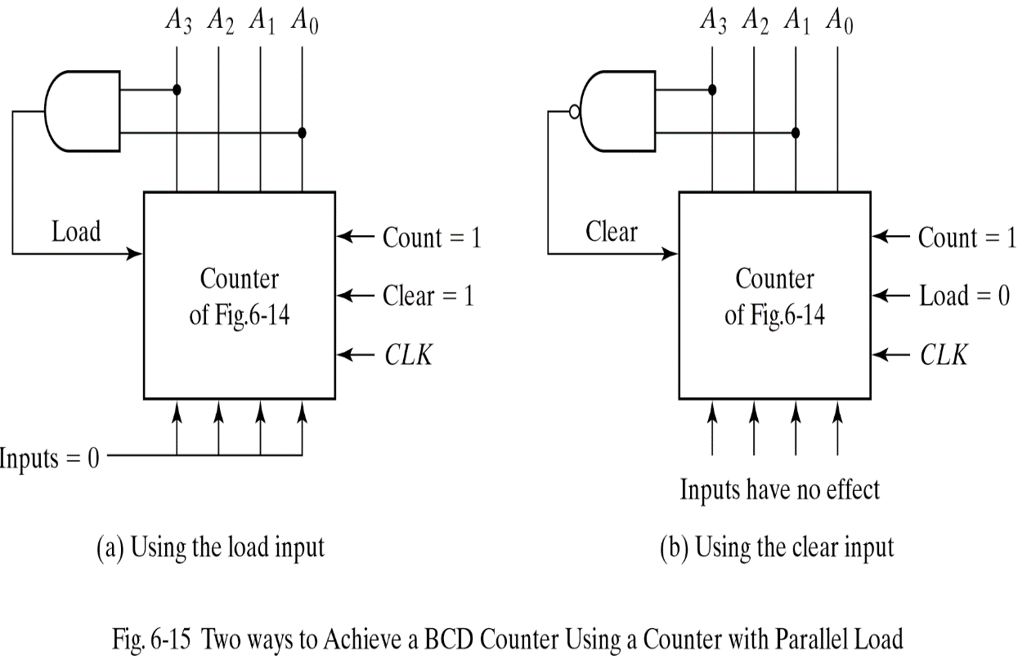
BCD COUNTER using Binary Counter with Parallel Load
The AND gate detects the occurrence of state 1001(9) in the output. In this state, the load input is enabled and all-0’s input is loaded into register.
The NAND gate detects the count of 1010(10) , as soon as this count occurs the register is cleared.
A momentary spike occurs in output A2 as the count goes from 1001 to 1010 and immediately to 0000
2022-11-29
*

Slide 21
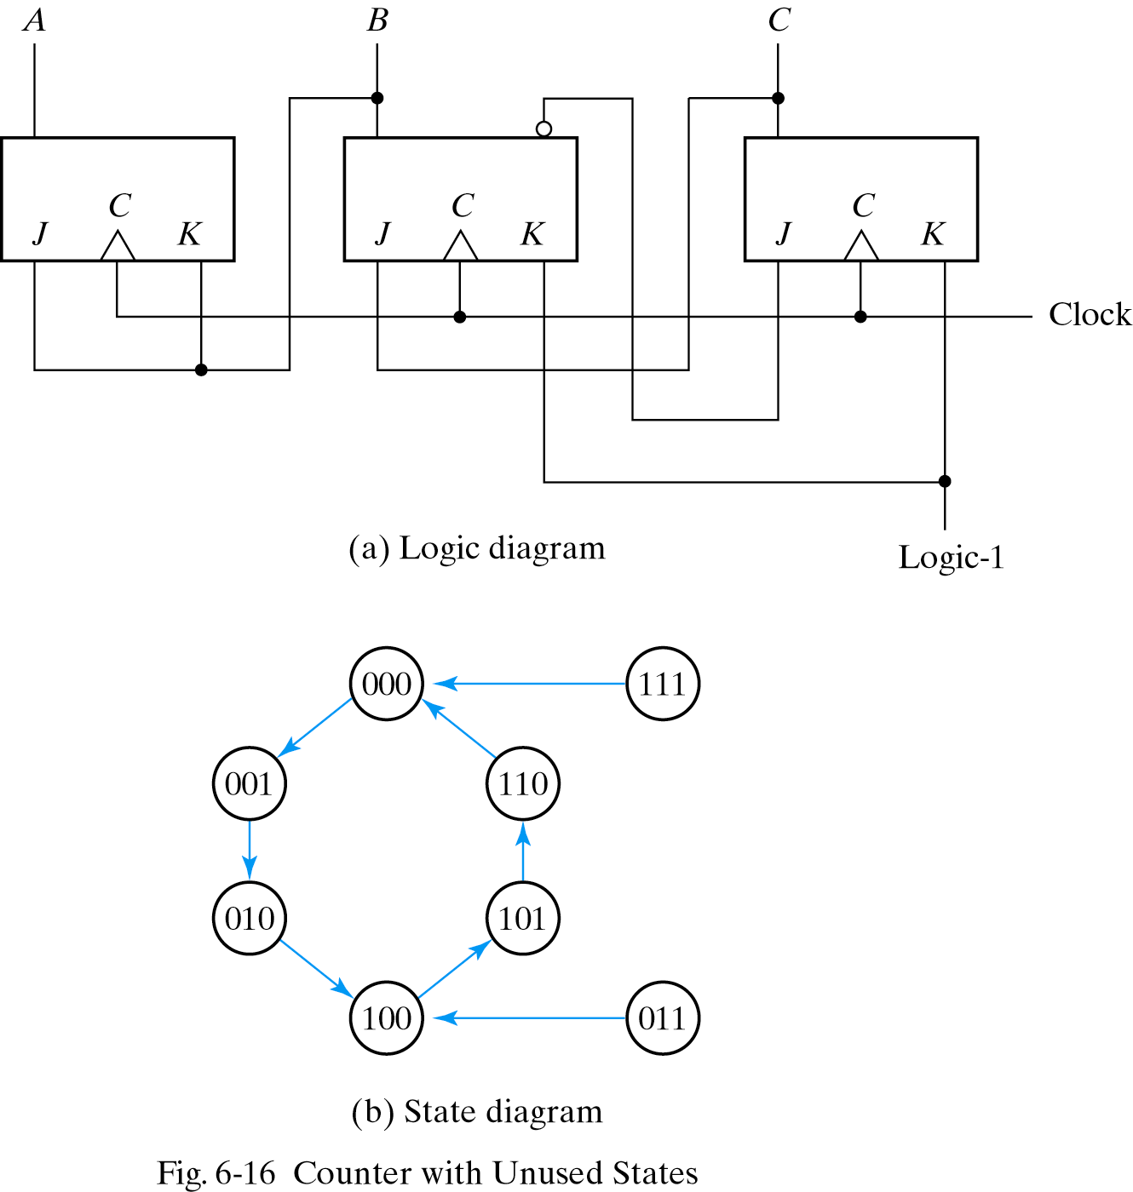
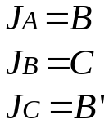
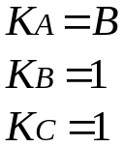
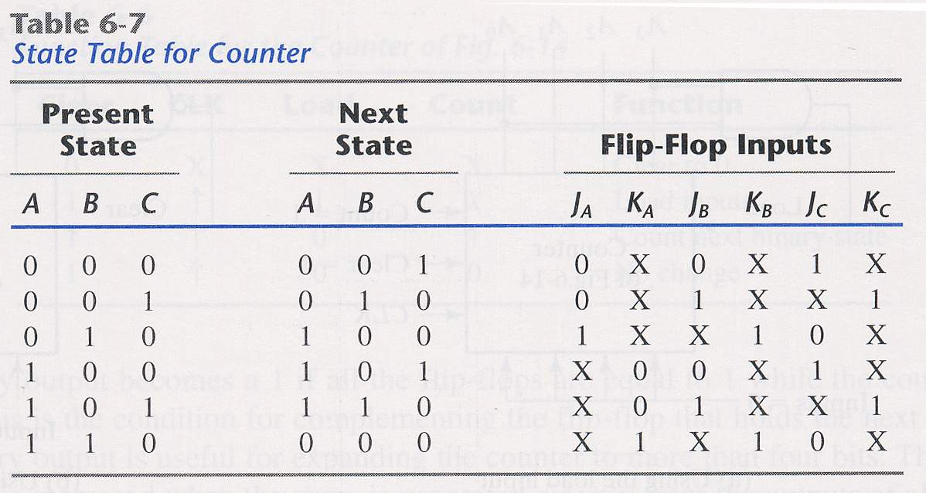
6.5 OTHER COUNTERS
Except 011 ,111
26年 11月 8日

Slide 22
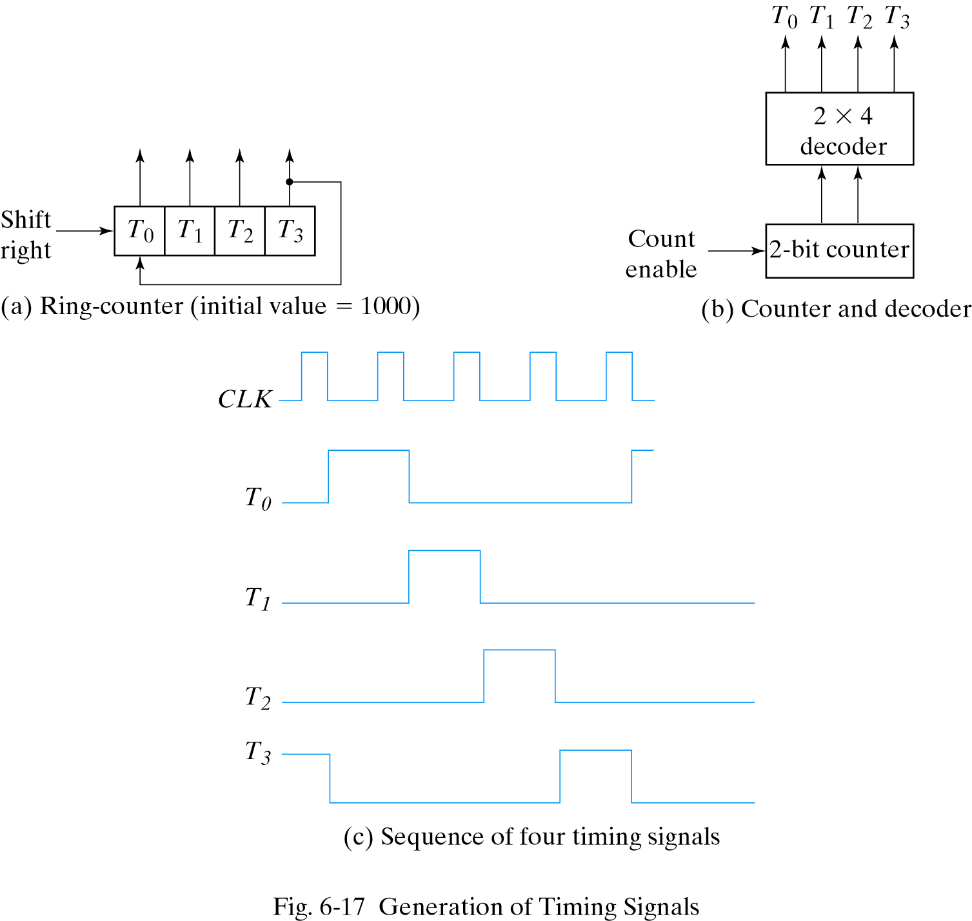
Ring Counter
A circular sift register with only one flip-flop being set at any particular time. ; all others are cleared.
The single bit is shifted from one flip-flop to the other.
26年 11月 8日

Slide 23
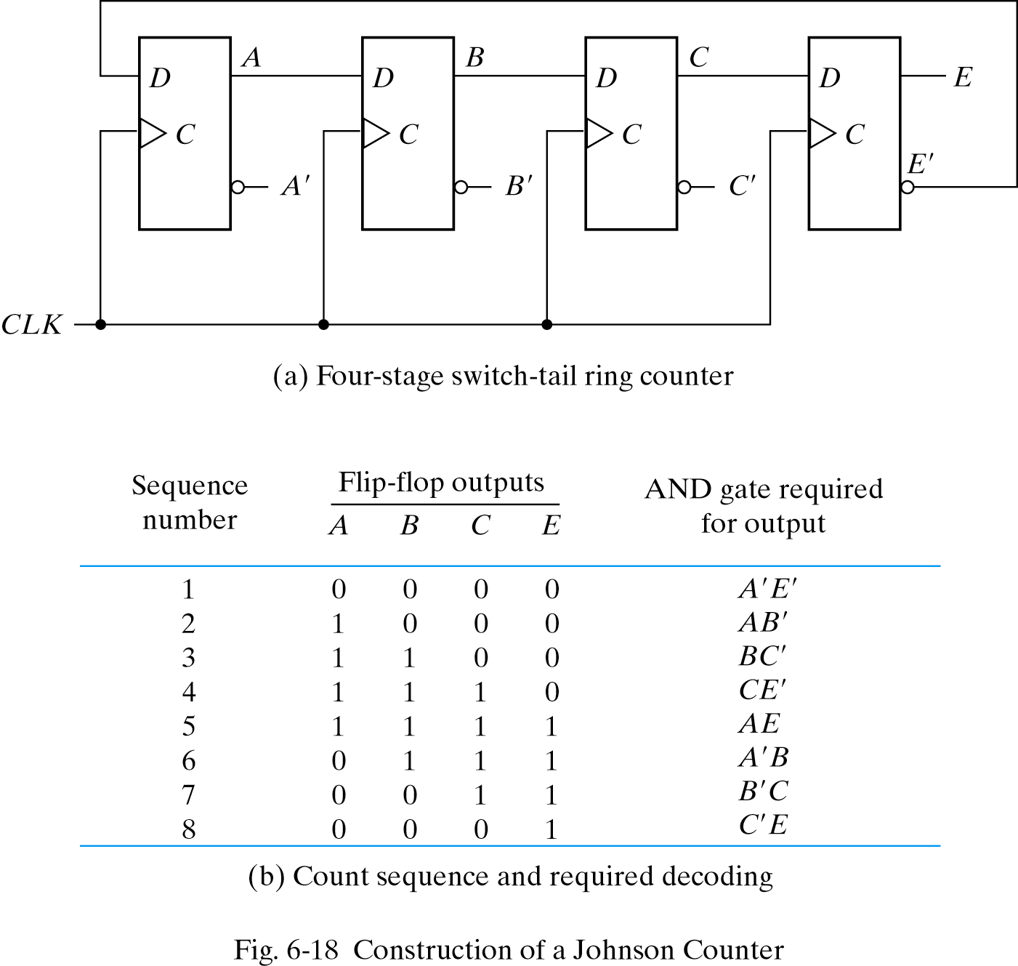
Johnson Counter
A circular shift register with the complement output of the last flip-flop connected to the input of the first flip-flop.
26年 11月 8日

